Slide 1
Cell Tower Analysis
Project 3
Team Can You Hear Us: Prajesh Patel, Nazih Bouanani, Corey Chickowski

Slide 2
Sources
OpenCellid API: https://opencellid.org/
OpenCelliD Project is licensed under a Creative Commons Attribution-ShareAlike 4.0 International License

Slide 3
Overview
Retrieved data from OpenCellid API.
Reviewed and manipulated the data in Jupyter Notebook using Python.
Loaded the data to a MongoDB database.
Created a Flask application with three available routes.
Used Javascript to create a map of the US visualizing the cell tower coverage by radio type.
Used Javascript library Chart.js to visualize a bar plot with the total number of cell towers by radio type.
Formatted and Styled our webpage using HTML and CSS

Slide 4
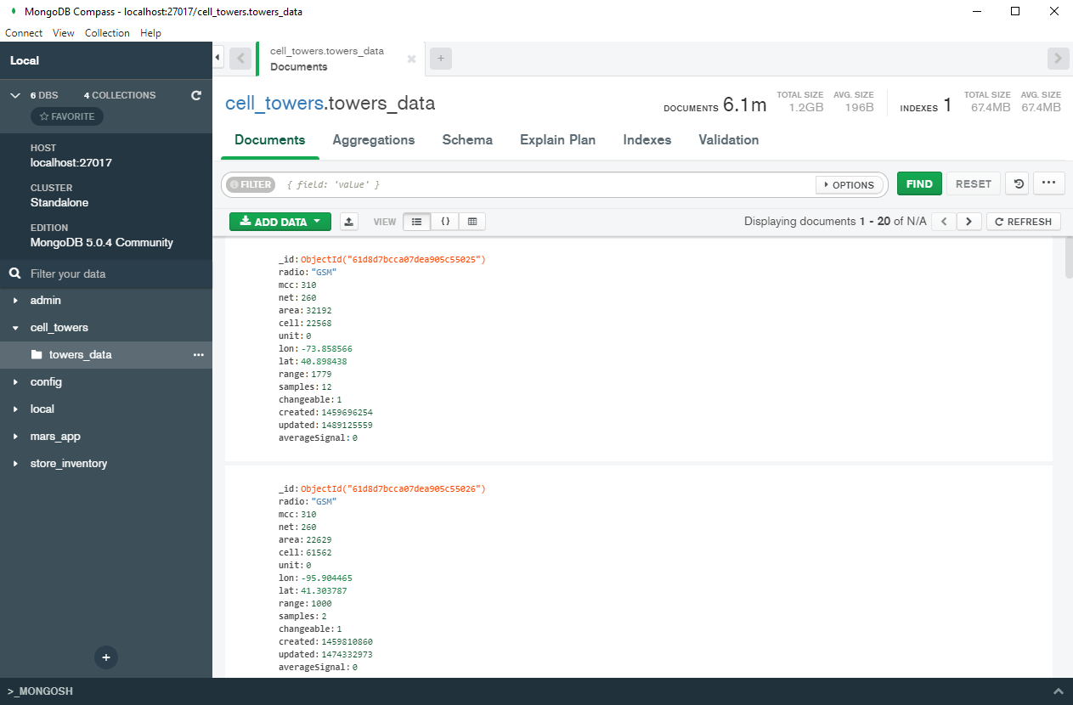
MongoDB Database

Slide 5
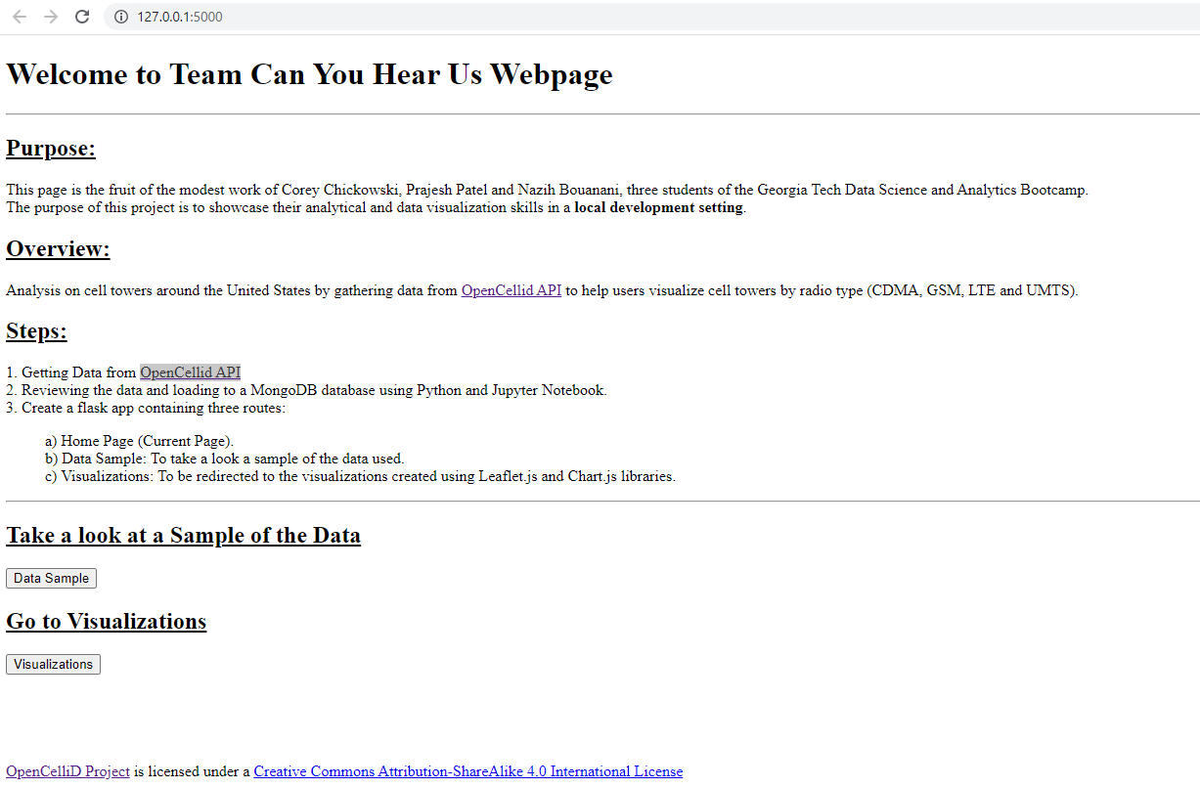
Home Page

Slide 6
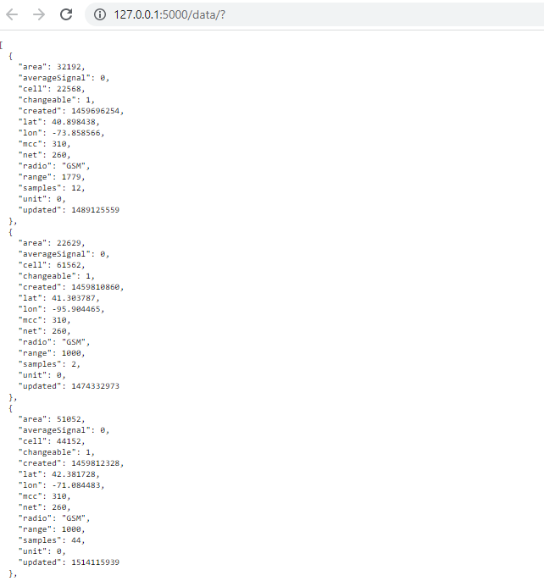
Data

Slide 7
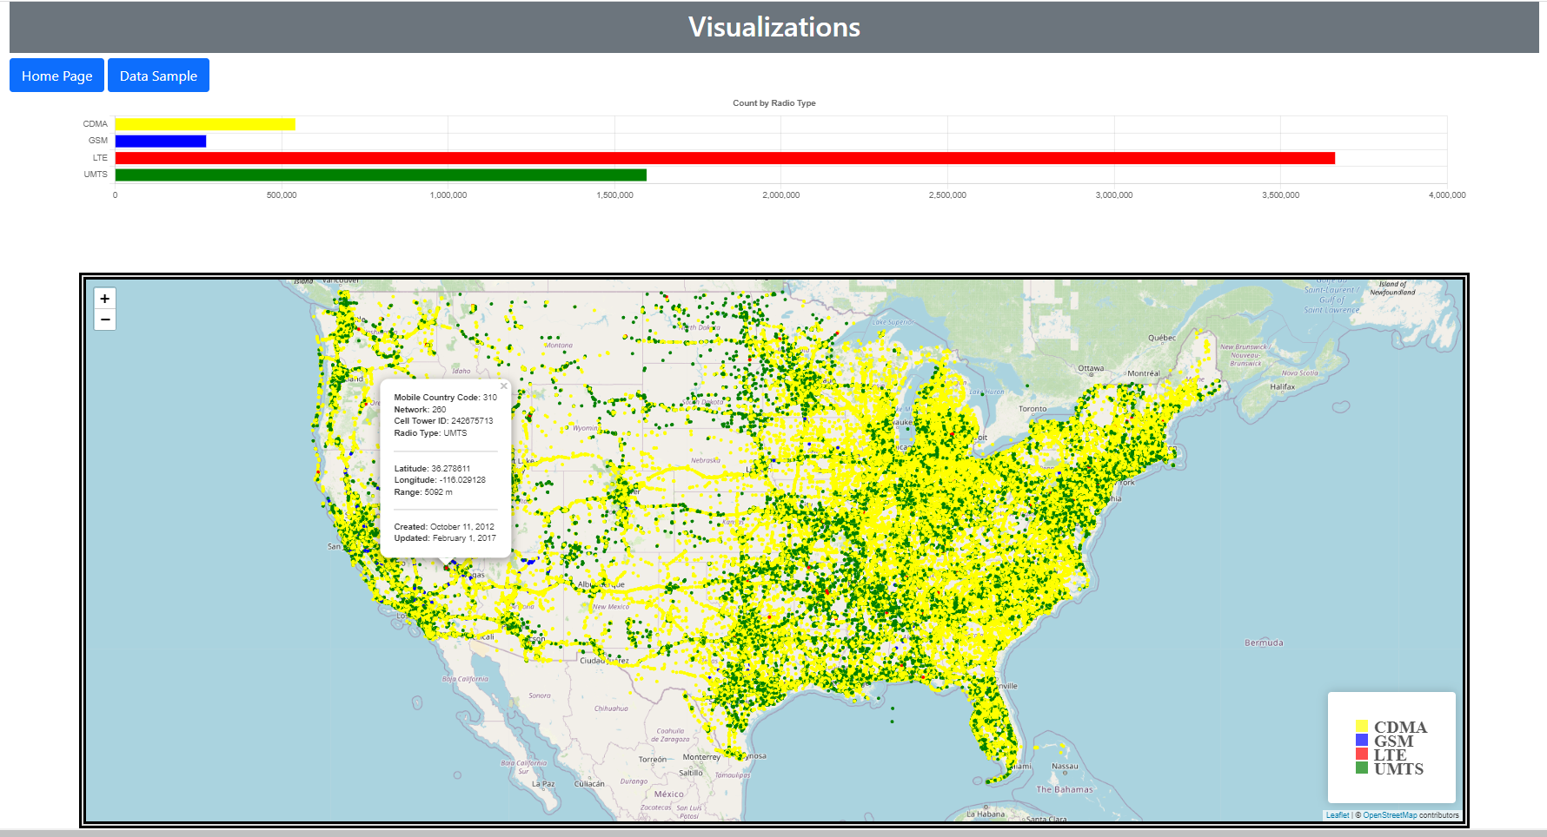

Slide 8
Project Challenges
There were over 6 million records for the United States based on the OpenCellID data available. Because we use the Flask application locally on our devices, we were forced to use smaller samples than the whole database to maintain peak performance of our visualizations.

